Slide 1
Indexes
Index | Key | Example
actors | actor | actor = ‘David Tennant’
characters | character | character = ‘Rose Tyler’
episodes | title episode | title = ‘An Unearthly Child’ episode = ‘1’ ‘episode:*’
planets | planet | planet = ‘Earth’
props | prop | prop = ‘Dalek One-7’ ‘prop:Dalek*’
species | species | species = ‘Dalek’ ‘species:S*n’
things | thing | thing = ‘Tardis’

Slide 2
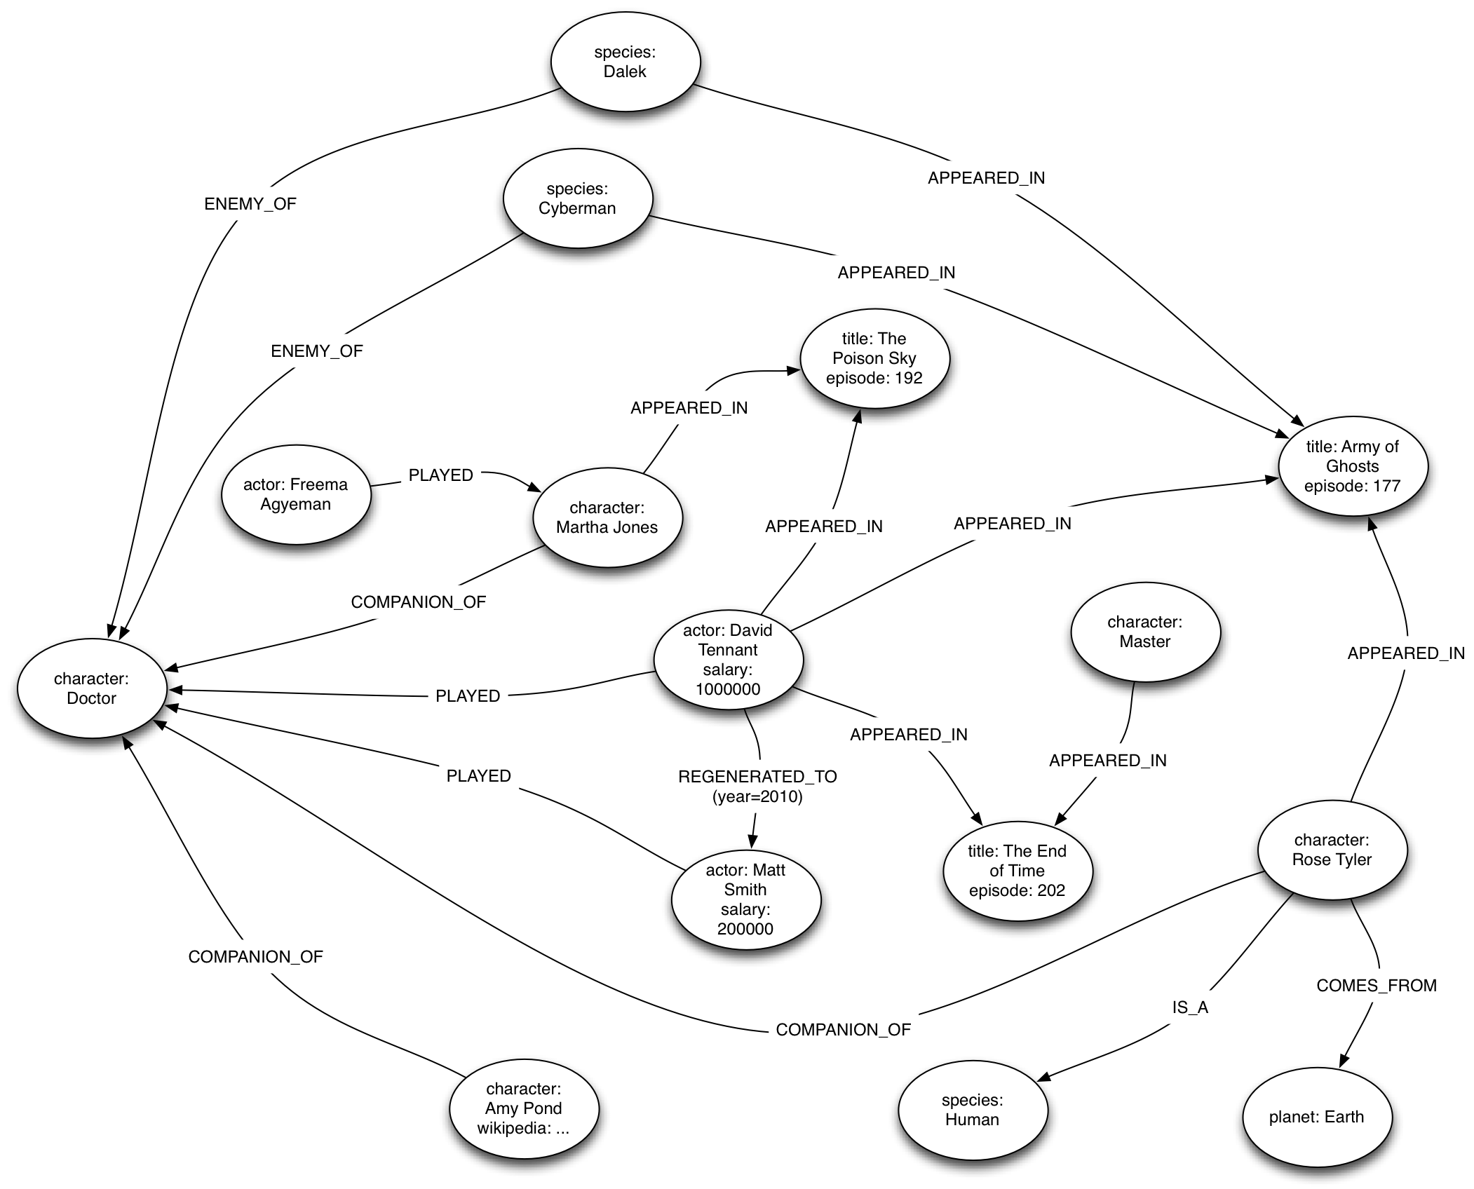

Slide 3
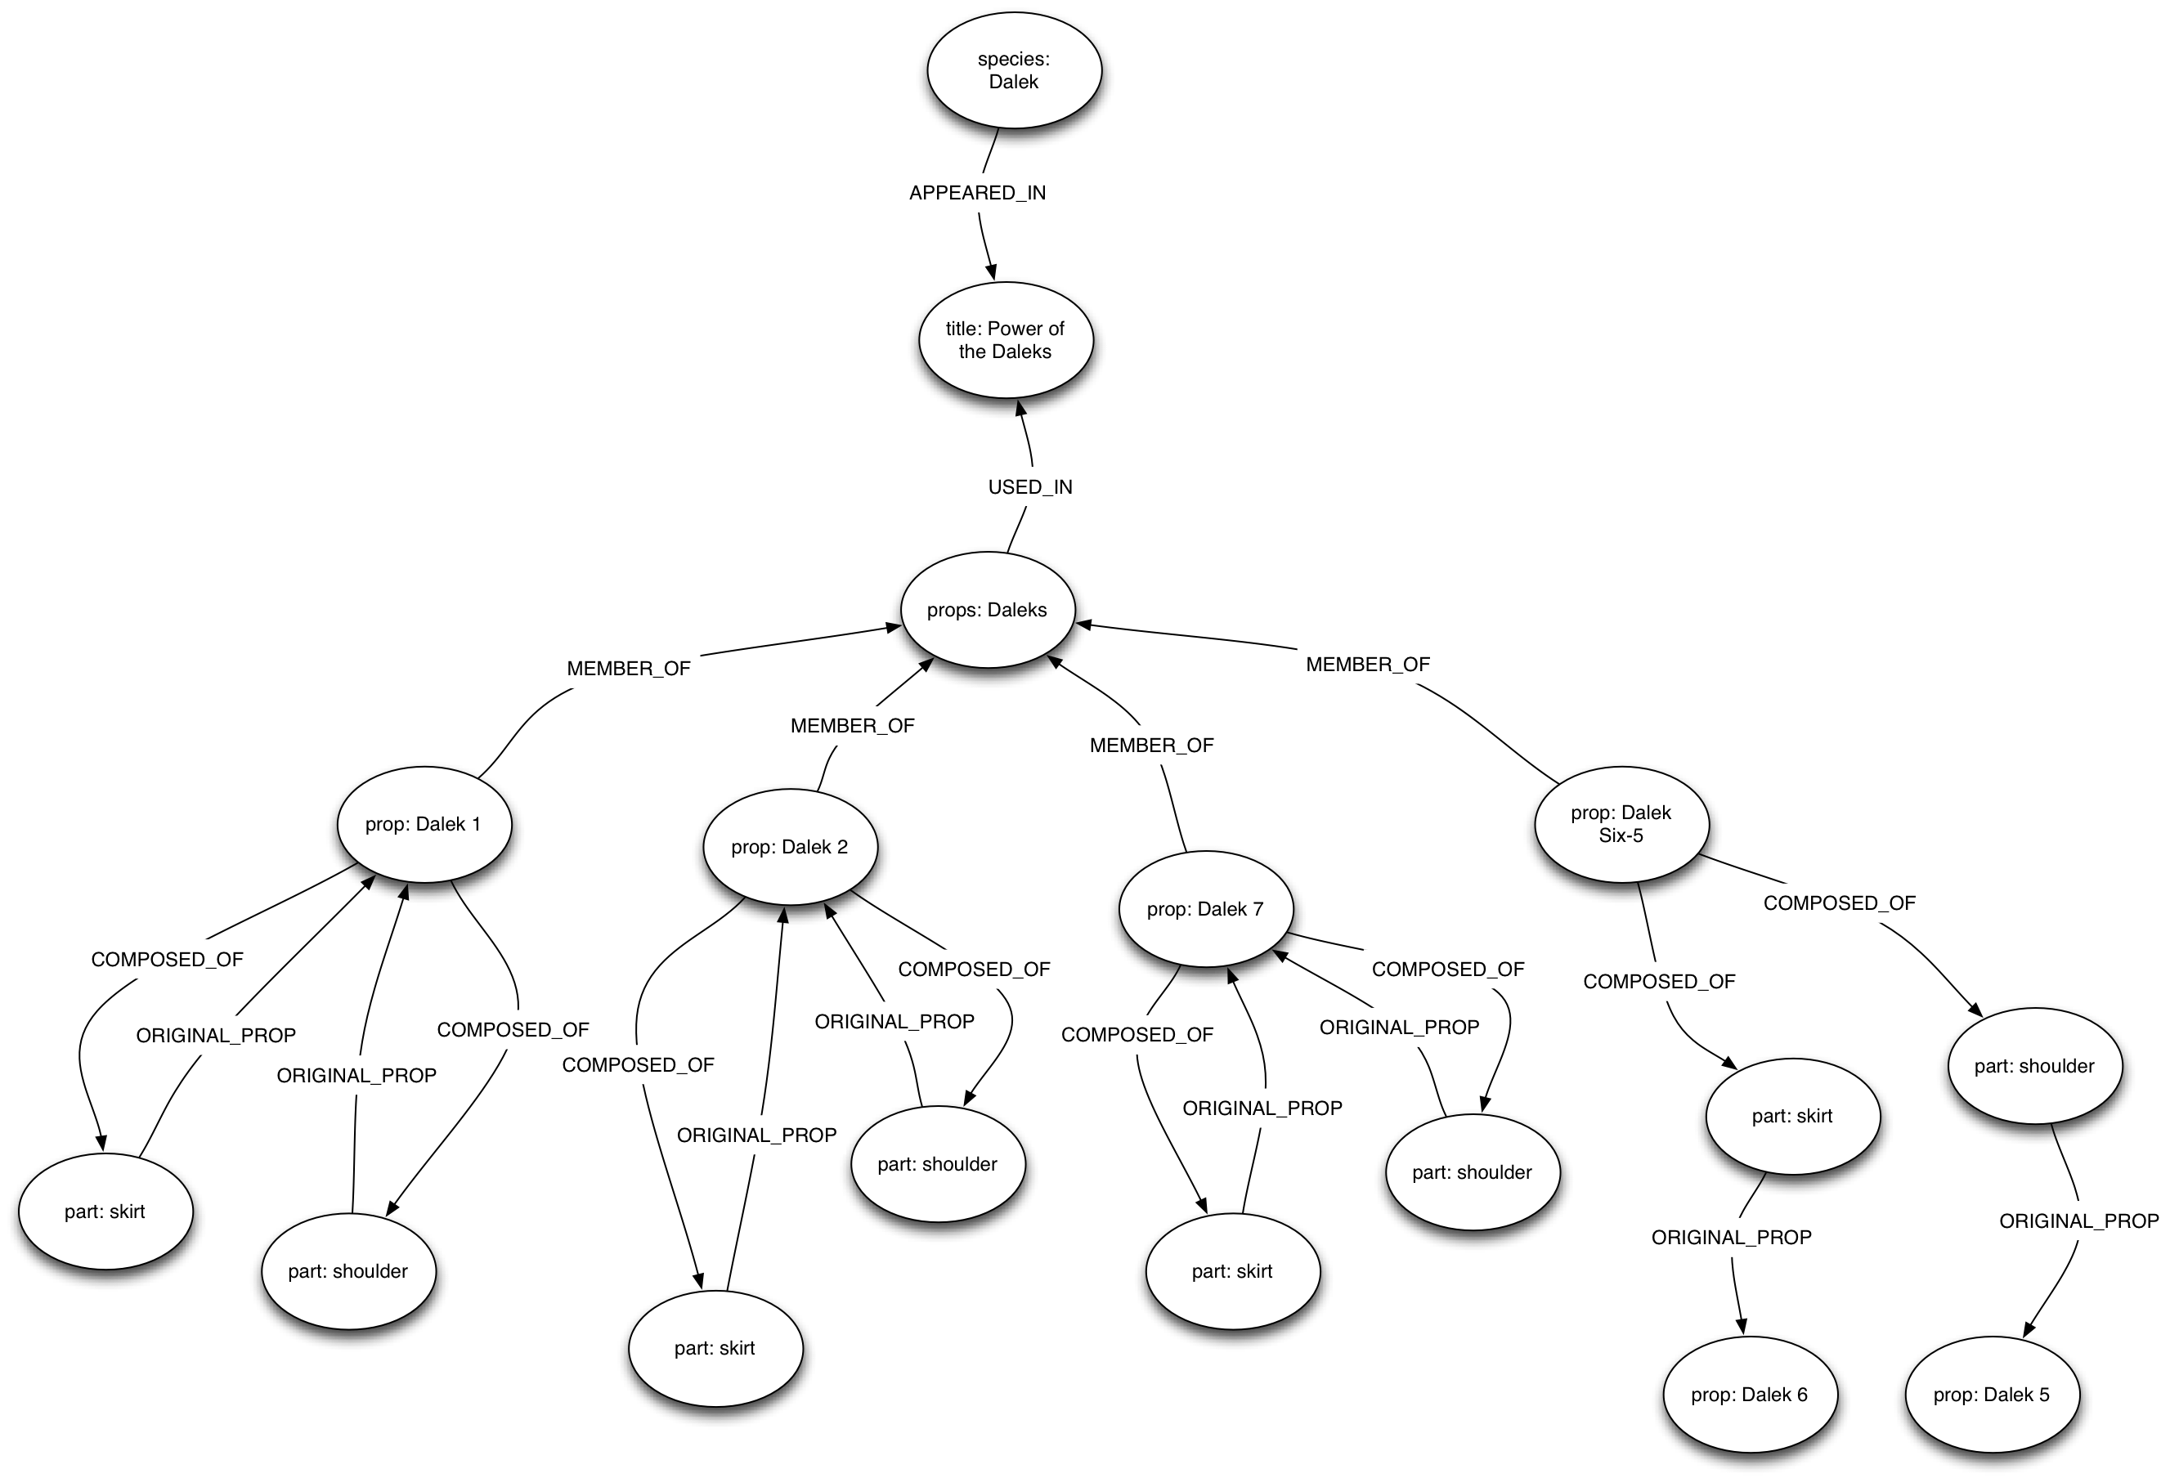
Dalek Props

Slide 4
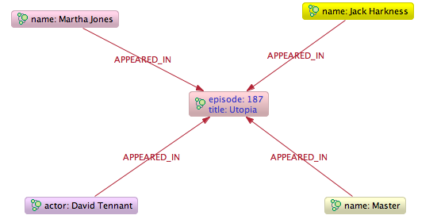
Episodes Containing David Tennant and The Master

Slide 5
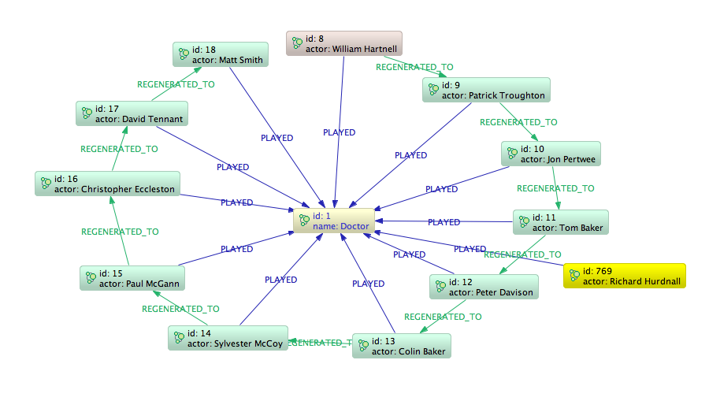
The Doctor Regenerates

Slide 6
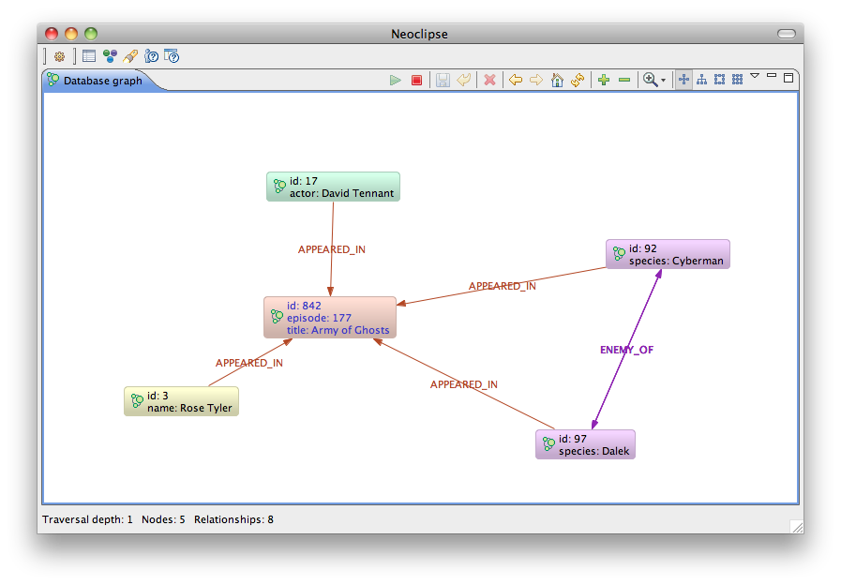
Episodes Where Rose Battled The Daleks

Slide 7
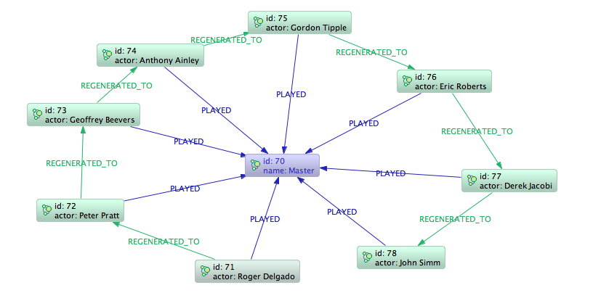
The Master Regenerates

Slide 8
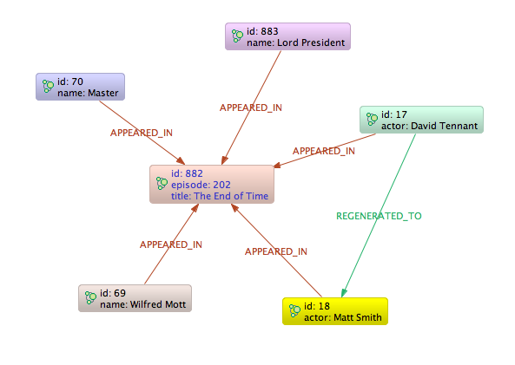
David Tennant Regenerates

Slide 9
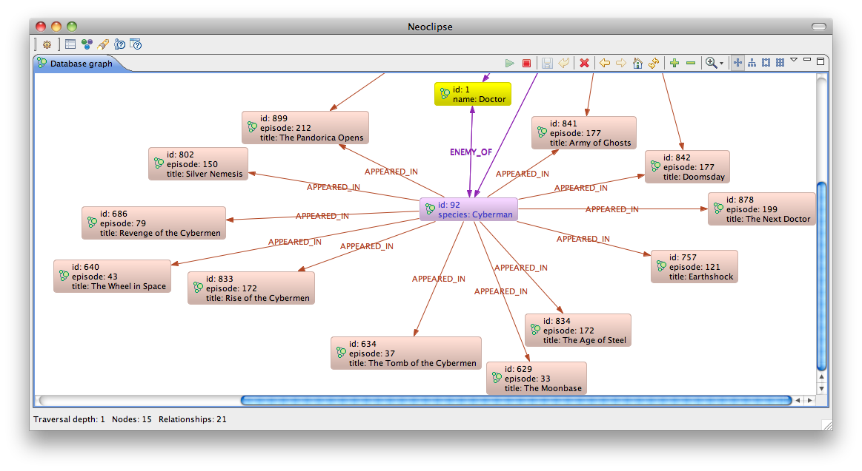
Episodes Where The Cybermen Battled The Doctor

